Slide 1
Effects of lack of CO2 during recording
For MEA NFA
April 28, 2022

Slide 2
Motivation
In the DNTFalseNegatives project in the 20210818 culture, the CO2 was found to be out/off in the Maestro during the DIV12 recording of 2 of the 3 MEA plates (so these plates lacked CO2 for only a little over 15 minutes)
We want to know if the data from these 2 plates is still usable

Slide 3
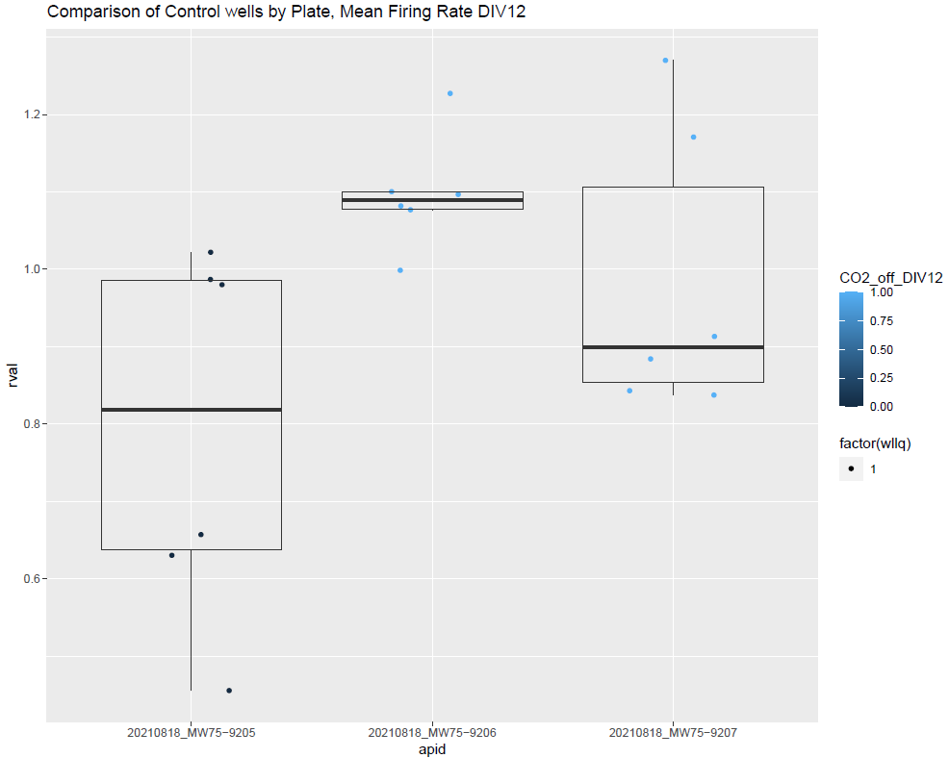
Comparing controls from the 3 plates
Since 1 of the 3 plates from this culture did have CO2 (75-9205), we can compare the values from the other 2 plates to this plate
If we compare the control values visually, there appears to be a difference between 75-9205 and the other plates for some endpoints on DIV12. Surprisingly, 75-9205 actually seems to have lower activity for several endpoints
However, it is difficult to determine if this degree of difference is biologically significant in the absence of other cultures and plates.
(taken from DNTFalseNegatives/ DNTFalseNegatives_summary_plots_2022-04-14.pdf)

Slide 4
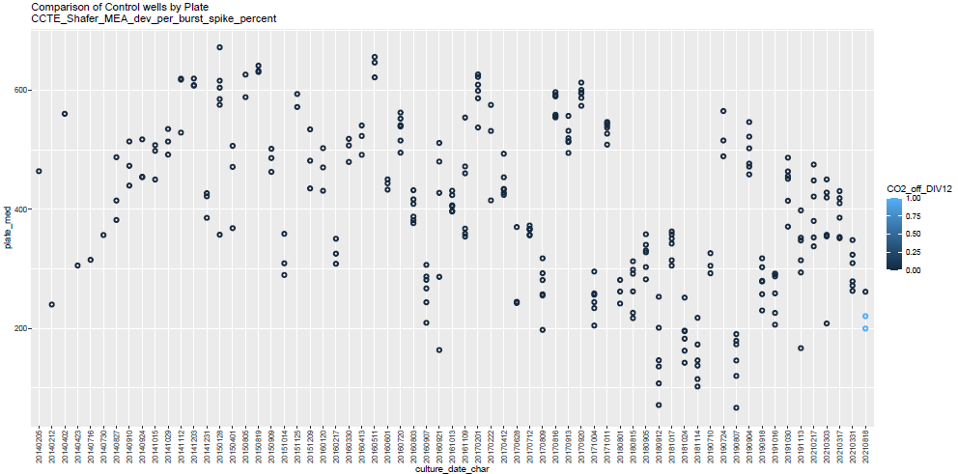
Compare platewise medians by culture across all MEA NFA data to date
We want to know if the lack of CO2 caused an effect on these 2 plates relative to 75-9205 that is greater than the typical plate-to-plate variability within a culture. Here, we examine the variability in the platewise medians of control by culture. Plates lacking CO2 during DIV12 recording are shown in light blue.

Slide 5
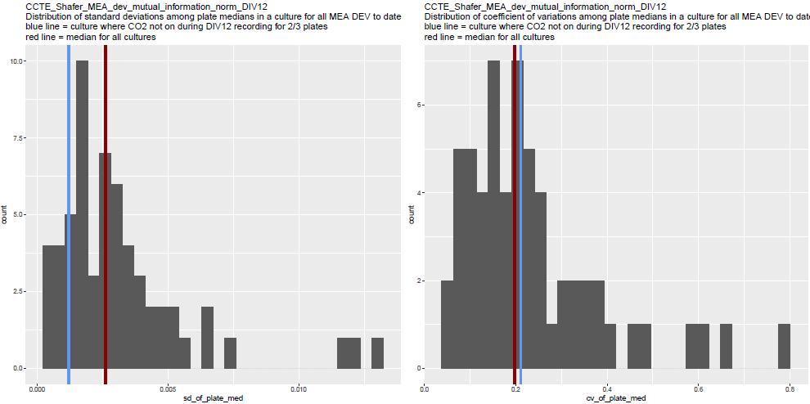
Compare platewise medians by culture across all MEA NFA data to date
To summarize the variability in plate medians within each culture, we calculated the standard deviation and coefficient variation of the plate wise medians within each culture (My thinking: SD = raw variance, CV = variance normalized to the magnitude of the typical response on the plate)

Slide 6
Compare platewise medians by culture across all MEA NFA data to date
For 19 of the 34 DIV12 and AUC endpoints, the SD and CV of plate medians from 20210818 was below the median of all cultures, indicating that the variability of the 3 plates from this culture is typical compared to the plate-wise variability in other cultures that didn’t have a lack of CO2 on some plates
However, the other 15 endpoints do seem to indicate some degree of higher-than-median variability in the plate medians from 20210818.
SD of plate medians from 20210818 vs. 50%-ile | CV of plate medians from 20210818 vs. 50%-ile | # of AUC or DIV12 endpoints (34 total)
Below | Below | 19
Below | Above | 6
Above | Below | 4
Above | Above | 5

Slide 7
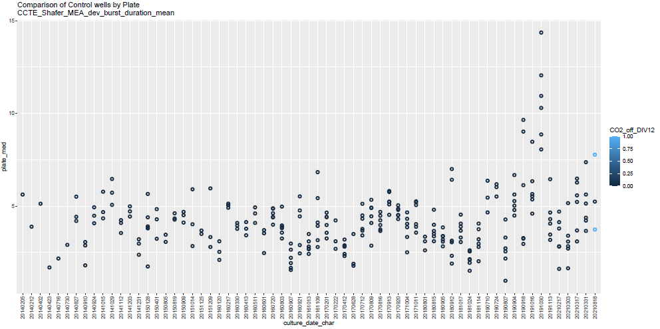
Compare platewise medians by culture across all MEA NFA data to date
For 4/15 endpoints with higher-than-average SD or CV for 20210818, the median of the plate that was not affected by a lack of CO2 during the DIV12 recording is actually in between the median from the 2 other plates
This makes me think that increased SD or CV is unlikely due to an effect caused by the lack of CO2. (But, the value without CO2 could just still be higher or lower than the value “would have been” with CO2 for each of the 2 affected plates individually, so this argument is not water-tight).

Slide 8
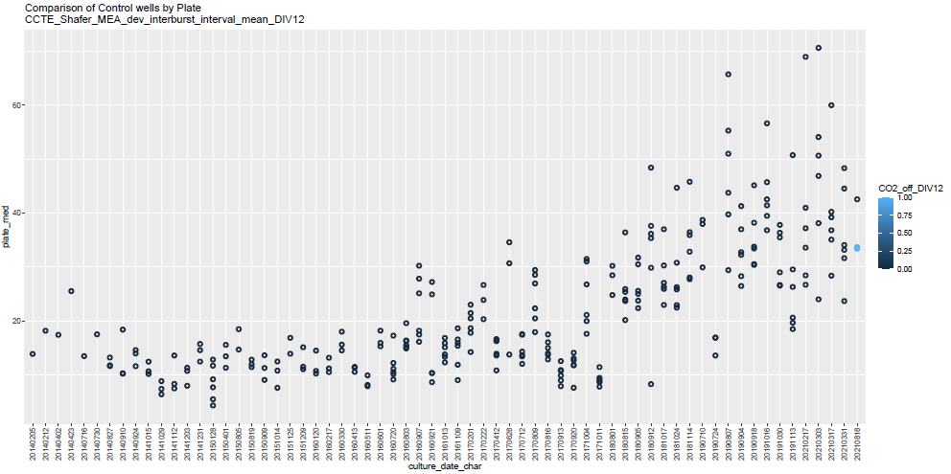
Compare platewise medians by culture across all MEA NFA data to date
For 3/11 remaining endpoints, the variability seems to be increasing over time. Therefore, the variability in 20210818 seems much less concerning when compared to the variability in more recent cultures only rather than the entire data set (though this trend is interesting on its own!)
Affected endpoints:
interburst_interval_mean_DIV12
inter_network_spike_interval_mean_DIV12
spike_duration_mean_DIV12

Slide 9
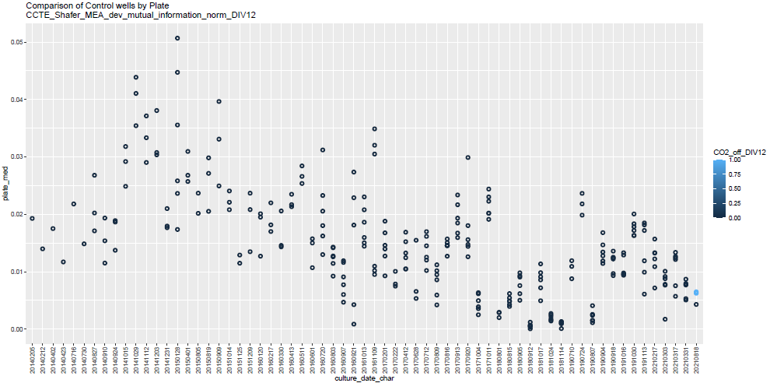
Compare platewise medians by culture across all MEA NFA data to date
For 3/8 remaining endpoints, the average value seems to be decreasing over time. Since the CV is the SD divided by the average, the CV is likely inflated for more recent cultures compared to previous cultures.
acnm target_cv_over_median target_sd_over_median
1: mutual_information_norm_DIV12 TRUE FALSE
2: mutual_information_norm TRUE FALSE
3: per_network_spike_spike_percent_DIV12 TRUE TRUE

Slide 10
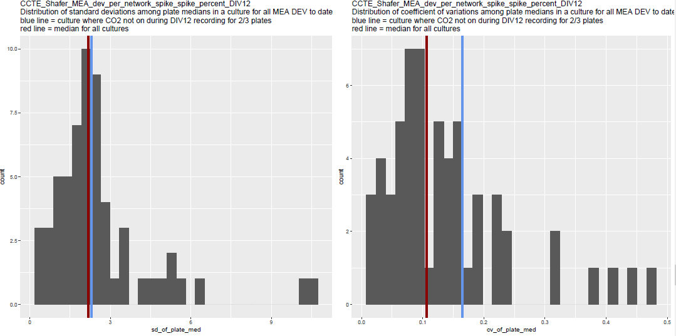
Compare platewise medians by culture across all MEA NFA data to date
Note that for per_network_spike_spike_percent_DIV12, the SD is elevated in addition to the CV. However, the SD is only slightly above the dataset 50%-ile when looking at the histogram.
SD
CV
acnm target_cv_over_median target_sd_over_median
1: mutual_information_norm_DIV12 TRUE FALSE
2: mutual_information_norm TRUE FALSE
3: per_network_spike_spike_percent_DIV12 TRUE TRUE

Slide 11
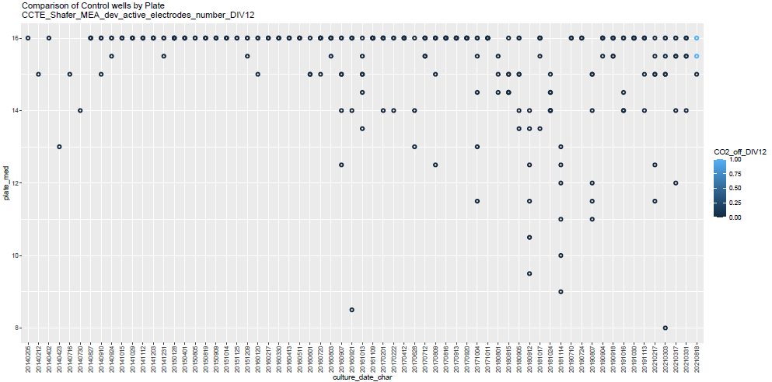
Compare platewise medians by culture across all MEA NFA data to date
For 2/5 remaining endpoints, I cannot explain the increase in variability for the 20210818 culture. However, the median value from the plate that did have CO2 actually indicates decreased activity relative to the other 2 plates. Thus, these 2 endpoints do not seem to indicate that the lack of CO2 suppressed activity.
Affected endpoints:
# active_electrodes_number_DIV12 (unaffected plate median value lower than other 2 plates)
# inter_network_spike_interval_mean (unaffected plate median value higher than other 2 plates)

Slide 12
Compare platewise medians by culture across all MEA NFA data to date
The final 2 endpoints (see next slides)
# network_spike_duration_std_DIV12
# per_burst_spike_percent
# per_burst_interspike_interval

Slide 13
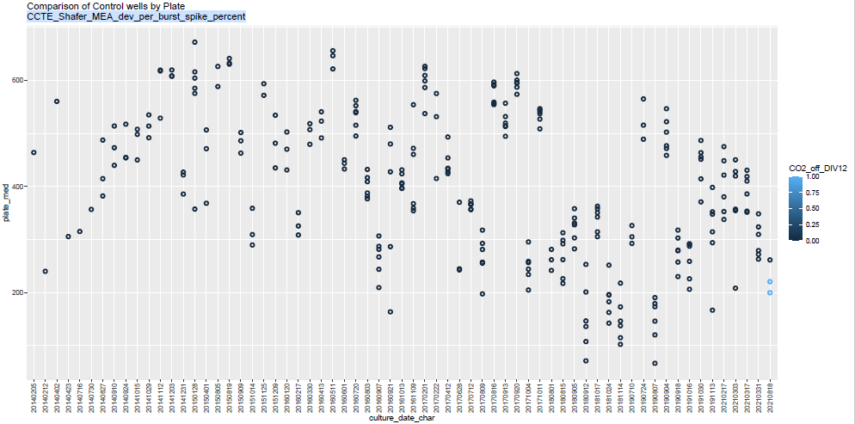
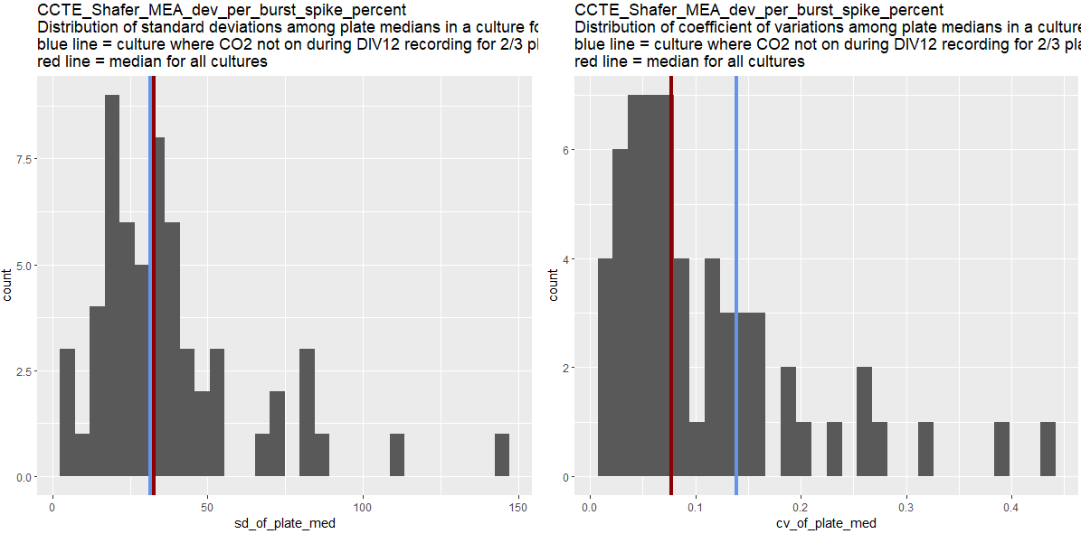
per_burst_spike_percent
CV is elevated, but not SD
An argument could be made that the value of this endpoint is decreasing over time (by culture), so the relatively high CV could be due to a smaller than average mean of plate medians in 20210818 (as observed for mutual information), though this trend is less consistent

Slide 14
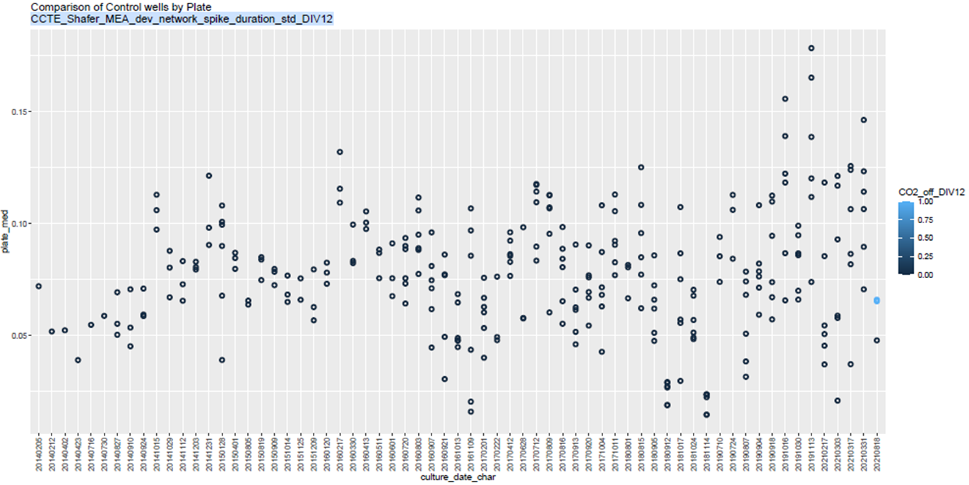
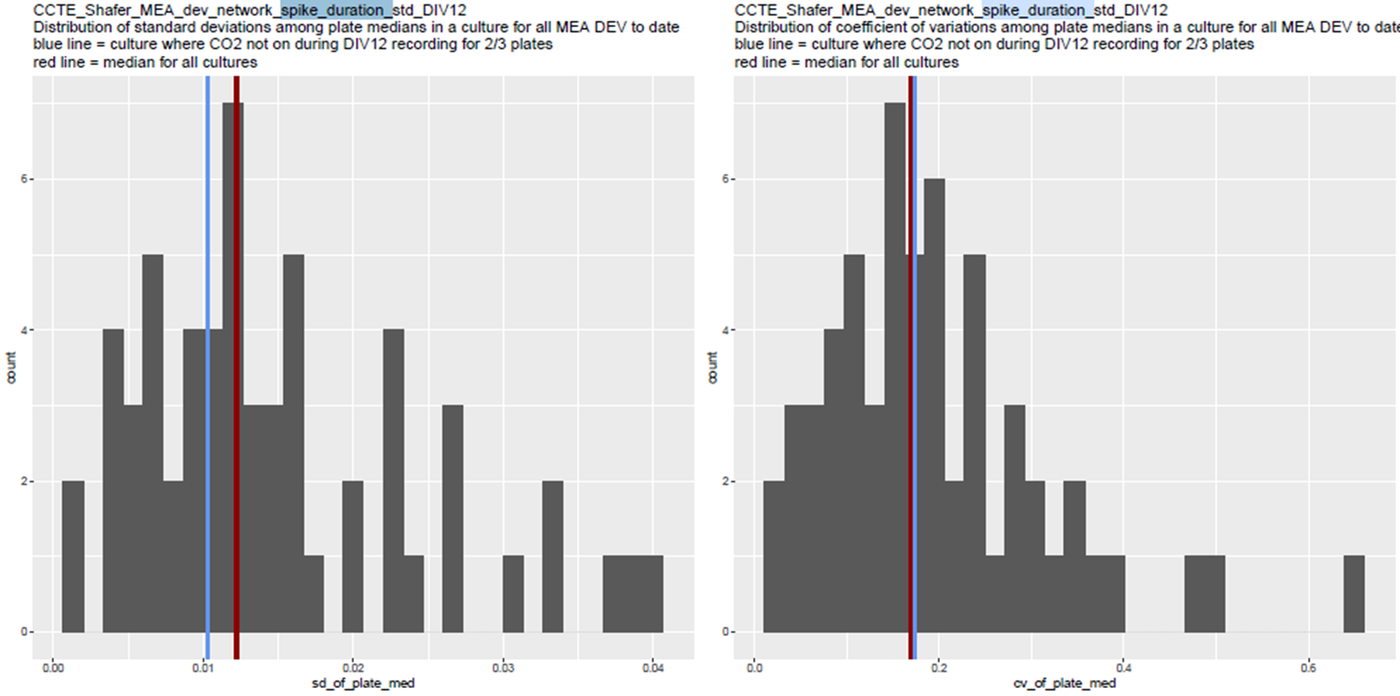
network_spike_duration_std_DIV12
CV is elevated, but not SD
Elevated CV seems slight when looking at the spread of values in the histogram

Slide 15
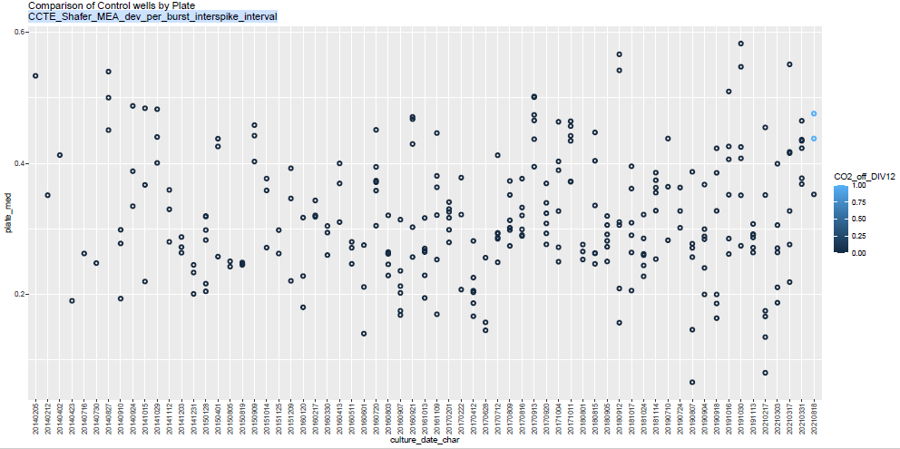
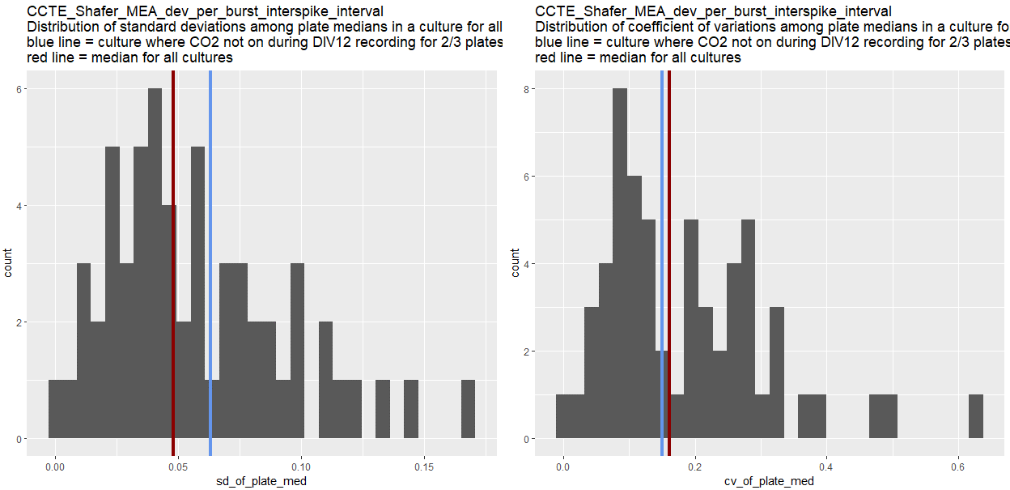
per_burst_interspike_interval
SD is elevated, but not CV
I don’t know.. I can’t really even prove that this endpoint is noisy, bc it all depends on the scale. There isn’t a clear trend over culture time.
Maybe this is an issue. But it’s just 1 endpoint. The values from the plates lacking CO2 seem perfectly fine compared to contemporary cultures.

Slide 16
Summary of the 15 endpoints with higher-than-50%-ile SD or CV of platewise medians in 20210818
Explanation | # of endpoints | endpoints
Median value from plate that did have CO2 is in between medians from plates that did not have CO2, indicating a lack of consistent effect | 4 | interburst_interval_mean burst_duration_mean dev_firing_rate_mean spike_duration_mean
Variability in plate medians appears to increase over culture time; variability in 20210818 seems negligible compared to more recent cultures | 3 | interburst_interval_mean_DIV12 inter_network_spike_interval_mean_DIV12 spike_duration_mean_DIV12
CV, not SD is the primary elevated measure for 20210818 and the average plate-wise medians appears to decrease over culture time. Since the CV is divided by the culture average, these CVs likely appear elevated because of the relatively small denominator of the CV, not necessarily due to increase variance. | 3 | mutual_information_norm_DIV12 mutual_information_norm per_network_spike_spike_percent_DIV12
No explanation, but median value from plate that did have CO2 actually indicates decreased activity relative to the other 2 plates, indicating that the lack of CO2 does not seem to decrease the activity. | 2 | active_electrodes_number_DIV12 inter_network_spike_interval_mean
No explanation, but effects seem insufficient to warrant removing the data in themselves | 3 | network_spike_duration_std_DIV12 per_burst_spike_percent per_burst_interspike_interval

Slide 17
Things I might do differently next time / other things to investigate
Ways to improve what I did, given the analysis route I chose
Would have been better look at/quantify the magnitude of the elevated CV or SD as a first-layer screen for problematic endpoints (it’s just tricky though, how do you quantify a negligible increase above the 50%ile without visually looking at the histogram? Maybe could have calculated the percentile?)
Quantify the increase/decrease in variability over time, so that this observation is not just visual
Did the early cultures only have 1 plate per culture? If so, would have been better to probably not includes those in the Sd/CV distributions, since those would have been 0 by default
This was great and thorough – is there any way I could have come to this conclusion with less work (along with appropriate support/justification/documentation)?
Different routes I could have/should have chosen
Has CO2 ever been missing during any other plate recordings? If so, would have been helpful to view more data points/examples.
I focused on comparing the platewise medians of the controls. BUT, 2 other potentially important factors
Variability in the replicate treatment-concs among the 3 plates matters as well
I’m still deciding if looking at whether the lack of CO2 caused an increase in the variability of controls within each plate would matter.
Wilcoxon rank sum test to compare the distributions of the values from each plate (pairwise I guess?)
See where p-values are signficant
THEN, look at the magnitude of differences in the distributions - compare that to the rest of the cultures.

Slide 18
My conclusion
I am convinced that for most endpoints, any effect caused by the lack of CO2 on these 2 plates is negligible compared to the typical plate-to-plate variability within a culture. Therefore, I think that the data from these 2 plates is usable.
On one hand, I want to know if what I’m doing is any good (does it make sense to look at the SDs and CVs? Are my explanations legitimate explanations?). But I also just want to be done and I “Feel convinced
Note from Tim May 3 2022: CO2 was determined to be helpful at some point in the assay development. But, for some of the earlier data (e.g. 2014), CO2 was not used during the recordings!

